Slide 1
CS1231 Tutorial 11
AY18/19 – WEEK 13
Andrew Tan

Slide 2
Trees
A graph is a tree if:
It has no circuits
It is connected
A graph is a forest if:
It has no circuits
It is not connected

Slide 3
Definitions
Terminal vertex / leaf – a vertex of degree 1
Internal vertex – a vertex of degree > 1

Slide 4
Some lemmas and theorems
Theorem 10.5.2 – Any tree with n vertices has n-1 edges
Lemma 10.5.3 – If G is any connected graph, C is any circuit in G, and one of the edges is removed from G, then the graph that remains is still connected.
Theorem 10.5.4 – If G is a connected graph with n vertices and n-1 edges, then G is a tree.

Slide 5
Rooted tree
A rooted tree has one vertex distinguished as a root
level of a vertex – the number of edges along the unique path between it and the root
height – max level of any vertex
parent, children, siblings, ancestor, descendant

Slide 6
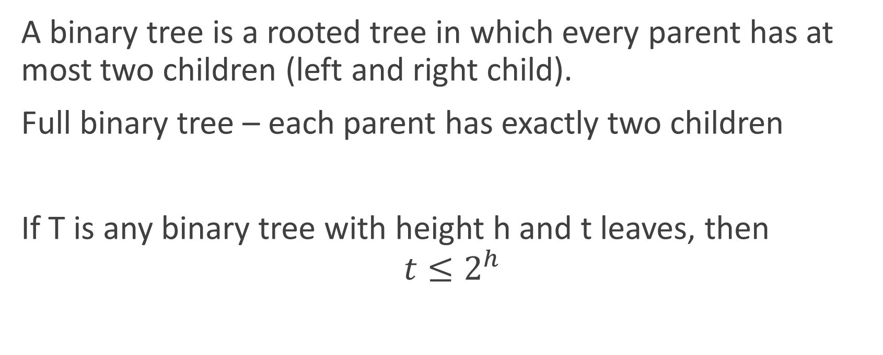
Binary tree
A binary tree is a rooted tree in which every parent has at most two children (left and right child).
Full binary tree – each parent has exactly two children
If T is any binary tree with height h and t leaves, then
$$t≤2^{h}$$

Slide 7
Binary tree traversal
Breadth first search – visit all nodes at current level before moving to next level
Depth first search – start at the root node and explore as deep as possible before backtracking

Slide 8
Spanning tree
A spanning tree for a graph G is a subgraph of G that contains every vertex of G and is a tree.
A minimum spanning tree is a spanning tree that has the least possible total weight compared to all other spanning trees

Slide 9
MST algorithms
Kruskal’s
Add edges in increasing weight without making a circuit
Prims’
- Build a MST by expanding outwards from some vertex

